Slide 1
On-boarding Academy
With
Greg Efta

Slide 2
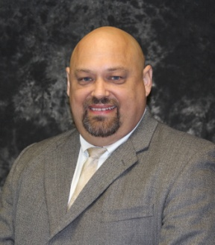
About Greg Efta:
Implementation Specialist at Custom Learning Systems
President of Performance Innovations
Senior Consultant at Maun-Lemke
Co-Founder of The QAPI Gurus
Co-Founder of Social Surge

Slide 3
You can find Greg Efta….
At gregefta@gmail.com
At www.gregefta.com
On Facebook
On Google+
On LinkedIn
Like Performance Innovations on Facebook and have access to “Today’s Nuggets”, “Fun Fact Fridays” and more!
Or the old fashioned way! 407.777.3757

Slide 6
What is On-Boarding?
Onboarding is more than just orientation and training. It involves creating a retention environment from the beginning, proper preparation and selection of the appropriate candidates, creating a welcoming environment and providing the ongoing social and supervisory reinforcement necessary to facilitate a long term employment decision.

Slide 7
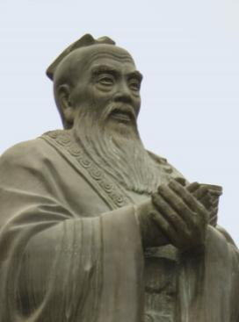
“Love what you do and you’ll never work another day in your life.” – Confucius

Slide 8
The Challenge
Not everyone loves their job!

Slide 9
Overview
Part 1: Turnover
Cost
Rates of turnover
What is possible?
Part 2: Pre – hire preparation
Behavioral Interviewing
Peer Interviewing
Peer Tour

Slide 10
Overview
Part 3: Pre-orientation Preparation
Three things that make a difference!
Part 4: Orientation
Five must haves!
Part 5: Mentors
Part 6: Recognition
Part 7: Checking In

Slide 11
Part 1:
Turnover

Slide 12
Turnover – What does it cost?
Department of Labor
$3,000 at minimum wage - $4,500 at $12/hr
Anecdotal Estimates
NJ NH company – 5 sites, 1,200 emps - $7,000
Gallop Estimates
1.5 times annual salary - @ $12/hr - $36,000
Your Estimates

Slide 13
Rates of Turnover
How many “bodies” did you hire for how many positions?
Most companies calculate overall turnover.

Slide 14
Do you know your year one turnover rate?

Slide 15
Typical First Year LTC Turnover Rate
60-180%

Slide 16
Tracking First Year Turnover Can Be Eye Opening

Slide 17
The First Year Turnover Hidden Challenge
A facility may have an overall turnover of 40% and feel good
But there may be a hidden challenge. For example…

Slide 18
Calculate First Year Short-Term Turnover
If a facility with 100 employees hired 40 during the year, the simple turnover percentage would be 40%.
But, if 80 of the 100 have been with the facility for over 1 year, then the 40 persons hired would have been to fill only 20 positions!
Effectively, that facility could have up to 200% short term turnover!

Slide 19
The bottom line about turnover…
You must know your year one turnover
Otherwise your global turnover rate can be an illusion

Slide 20
The Philosophy Behind Behavioral Interviewing:
“The only predictor of future behavior, is past behavior.”

Slide 21
Part 2:
Pre-Hire Preparation

Slide 23
Behavioral Interviewing

Slide 24
What exactly, is behavioral interviewing and why should I care?

Slide 25
Behavioral Interviewing is:
Behavioral interviewing is a smart approach to interviewing prospective employees
It rests on the premise that “Past performance is the best indicator of future performance”
And asks “what did you do” instead of traditional “what would you do” types of questions

Slide 26
Behavioral Interviewing Asks:
Asks questions in the format of:
“Tell me about a time when…”
“Give me an example in the past where…”
“Share with me what you did when…”
“In the past, when… happened, how did you handle it?”

Slide 27
It Predicts the Future by Requiring:
The interviewer to …
Prepare in advance the core questions to be asked
Active listening – listening to gain insight and depth
Patience! (moments of silence are okay!)
Is up to five times more effective at identifying a candidate’s strengths and challenges
Is up to five times more effective at predicting future performance

Slide 28
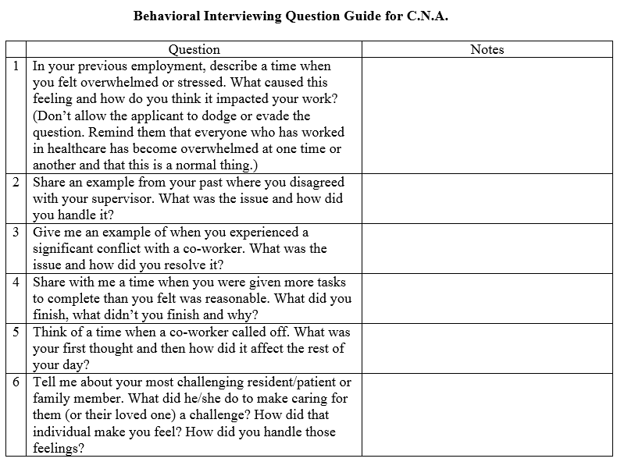
Featured Implementation Tool #7
Behavioral Interviewing Question Guide – CNA Position

Slide 29
Peer Interviewing

Slide 30
Have you ever made a hiring mistake?
How much support did your staff give that new team member?

Slide 31
A More Typical Response
“Look what they’re sending us now…”

Slide 32
The Point
With Peer Interviewing:
The likelihood of mistakes goes down
Peer support and opportunities for success goes up
It’s an opportunity to create a new paradigm
Not “They’re doing it to us” – Rather “We’re in this together”

Slide 33
Peer Interviewing is:
Engaging frontline staff in the selection process of hiring for (CNA, for instance) to assist in the interview process
An added step in the interview process and does not replace traditional interviews by supervisor(s), Human Resources or other management team members
And can be conducted by an individual or a panel (usually of three peers)

Slide 34
Four Key Benefits:
Builds confidence in the selection process at the frontline level
Allows exceptional frontline team members an opportunity to be involved in the decision making process
Creates a “shared ownership” in the success (and longevity) of newly hired team members
Creates an instant bond between new hires and peer interviewers – critical in the first few days

Slide 35
Choose Positive Peer Interviewers:
Peer Interviewers:
Are trusted frontline professionals
Have good attendance records
Have a positive attitude
Have had no performance issues in the previous 12 months (or longer)
Have demonstrated initiative and a willingness to go the extra mile
Want to contribute in meaningful ways to organizational improvement

Slide 36
Choose Positive Peer Interviewers (Continued)
Peer interviewers:
Are respected by their own peers
Are seen as mentors or leaders in their positions
Are willing to learn new skills and be trained in specific interviewing do’s and don’ts
Have strong communication skills, interpersonal skills and represent the organization well
Have a strong sense of mission and resident centered focus

Slide 37
Who Conducts Peer Interviews:
Peer Interviews can be:
Conducted by a single peer, just as a standard interview with a supervisor or manager would be conducted
Conducted by a panel (usually three) where each panel member takes turn asking questions
Done as a Peer Tour… More on this later
Done in conjunction with the supervisor or manager interview

Slide 38
What Peer Interviewers Ask:
Peer Interviews should explore:
Interpersonal relationships – how well will the candidate fit in to the culture of the unit or department?
Communication skills – how well does the candidate express her/himself and will she/he give and receive good information?
Work ethic – does the candidate have what it takes to get the work done?
Are really the same questions supervisors should ask.

Slide 39
What Peer Interviewers Should Look For?
Peer Interviews should explore:
Resident relations – how does the candidate view residents? Are they a gift or a curse?
Organizational commitment – how would they view their role in the organization? Agitator or Asset?
Mission – Does the candidate have a sense of a higher purpose in their work or is it just a paycheck?

Slide 40
The “Peer Tour”

Slide 41
Peer Tours
Hi, I’m Beth and I’d LOVE to give you a tour of our facility while you are waiting for Nancy!

Slide 42
Peer Tours
That would be very nice. I would enjoy the walk.

Slide 43
Peer Tours
I can observe you… Interact with Residents, interact with staff, react to the sights and sound of our building

Slide 44
Peer Tours
Maybe the walk will help me relax for my interview! I can see what it’s like here without the pressure.

Slide 45
Peer Tours
I’ll observe your body language and pay attention to the questions you ask. I can tell if you will fit in.

Slide 46
Peer Tours
I can be myself and not have to try to impress anyone. That will get me comfortable for my interview!

Slide 47
Peer Tours
You’re having an interview right now!

Slide 48
Proceed with Caution….
The entire applicant interview process should be based on fairness, consistency, ethical and legal behaviors
Included are two key reference guides peer interviewers need to know:
Americans With Disabilities Act Legal Questions
What You can Ask and What You Can’t – Legal/Illegal Interview Questions

Slide 49
Proceed with Caution…
Example:
Working Weekends

Slide 50
What You Can and Cannot Ask
Cannot
Can
“Do you go to church every Sunday?”
“We have a 24/7 need for staff. Is there anything preventing you from working Saturdays or Sundays?

Slide 51
What You Can and Cannot Ask
Cannot
Can
“Do you have any health problems?”
“Are you capable of performing all of the duties listed on the job description?”

Slide 52
What You Can and Cannot Ask
Cannot
Can
“Do you have any children?”
“What hours are you available to work?”
Or
“Do you have any responsibilities that would prevent you from travel, if needed?”

Slide 53
What You Can and Cannot Ask
Cannot
Can
“What country are you from?”
“Are you authorized to work in the US?”

Slide 54
Peer Interview Go/No Go
Recommendation:
Hire new prospective team member if two of the three interviewers agree
Unless the third one had a bad first hand experience

Slide 56
Part 3:
Pre-Orientation Preparation

Slide 57
“50% of workforce satisfaction comes from employees relating with their boss.”
– Beverly Kaye
How are you relating?

Slide 58
The Nightmare Scenario
50% of New Hires did not show up!

Slide 59
Four Important Advanced Preparation Steps
Once a candidate has been hired, there are several steps to take in advance of their first day:
Welcome Letter/Gift – sent to the new hire’s home address immediately after confirmation of offer
Welcome Phone Call to new hire, two or three days prior to scheduled orientation
Internal preparation at department/unit level to welcome new hire(s)
Posters, signs and other printed materials prepared in advance of their first day

Slide 60
Start with a Sincere Welcome Letter
The letter should:
Come from the Administrator
Express sincere appreciation for their decision to join the team
Express enthusiasm for getting to know them
Should define, briefly, the mission or culture of the organization and how the new hire can fit in
Affirm the scheduled formal orientation date and time
Provide contact information in case of questions
PS – add a sincere handwritten personal note

Slide 61
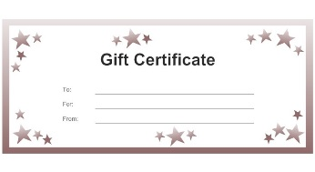
Include a Pleasant Surprise:
May include a small gift, such as
A Starbuck’s gift card ($5 or $10 is fine)
A local merchant gift card
A gift certificate for a free lunch or dinner on campus or off campus
Flowers
Small fruit basket
Other gift in the $5 - $10 range

Slide 62
Next – the Surprise Welcome Phone Call
The call should:
Be made two or three days in advance of formal orientation
Confirm date, time, and length of first day
Can cover things such as direction so the facility, parking, location of training area, contact person on campus, dress code expectations, lunch plans, basic itinerary, cell phone policy, etc.
Explores any questions the new hire may have
Sets the tone for the expectations the organization has of the new hire/positive

Slide 63
Get the Ball Rolling Internally
Notify department or unit of new hire’s name, date of orientation, position and other pertinent information
Welcome sign is printed and ready for first day
Picture of new hire is included (if available)
Plans are initiated for a brief welcoming party/event on first day of orientation

Slide 64
Orientation Day Checklist
Provide welcome signs for orientation day for entry way or lobby – “Today we welcome…”
Post direction signs to guide new hires to orientation area
Order refreshments for orientation day
Remind supervisors to participate in orientation (if needed)

Slide 65
Orientation Countdown
Orientation materials prepared and available (employee handbooks, forms, job descriptions, etc.)
Training materials are duplicated
Time badge, time card or other time clock related items are readied
New Team Members Name badges are prepared and ready

Slide 66
A Final Thought

Slide 68
Part 4:
Orientation

Slide 69
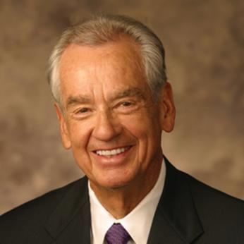
“The only thing worse than training your employees and losing them, is not training them and keeping them.”
– Zig Ziglar

Slide 70
Question
Can you imagine starting a new job…
and not getting told to clock in for 3 days!

Slide 71
Orientation-Excellence
Every community must develop their own, unique customized orientation education program. Here are some general guidelines :
Every New Hire MUST complete orientation before being scheduled to work
Make it fun and interactive
Go beyond the requirements – not just Policies and Procedures, Rules and Regulations, Required Training and forms

Slide 72
Orientation-Excellence (continued)
Start off with an icebreaker exercise (utilizing the Getting To Know You forms)
The foundation should be your Mission, Vision, Values and Service Standards/Care Promises
Provide refreshments, lunch, breaks and time to get to know each other

Slide 73
Orientation-Excellence (continued)
Plan a Welcome Event in each department/unit for the New Hire – usually in the afternoon on the first day (See “New Team Member Engagement Chapter”)
Invite participants to evaluate the process at the conclusion
Make Sure it is Competency Based
PS: Make sure Orientation is consistent from group to group

Slide 74
Where are your people learning these Service Communication Skills?
?
Question

Slide 75
Engagement begins with a “first date”!
Getting to know new hires is critical to forming a long term employment relationship
Use an engagement tool such as the Getting to Know You form and an icebreaker exercise

Slide 76
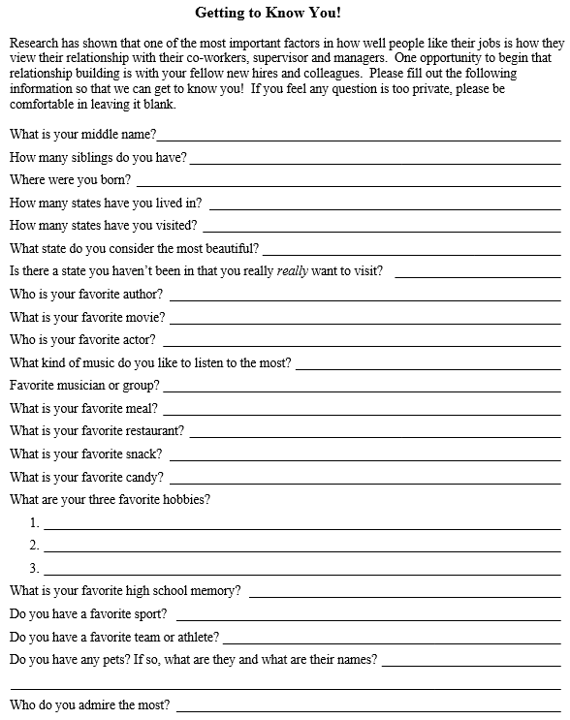
Featured Implementation Tool #21
Getting to Know You! Form
Invite every new team member to spend about 15 minutes answering questions they may not have shared in the typical brief introduction on the first day

Slide 77
Getting to Know Your New Team Member
How many siblings do you have?
Where were you born?
Do you have any children?
Do you have any pets? If so, what are they and what are their names?

Slide 78
Getting to Know Their Likes
What is your favorite movie?
What kind of music do you like to listen to the most?
What is your favorite restaurant?
What is your favourite snack?

Slide 79
Getting to Know Their Interests
Do you have a favorite team or athlete?
If you could live anywhere, where would it be?
What is your dream vacation?
What are your three favorite hobbies?

Slide 80
Getting to Know Them Well
What do you cherish the most?
What do you consider to be the most important thing in your life?
What is one interesting fact about you that very few people know?
What else would you like to share about yourself?

Slide 81
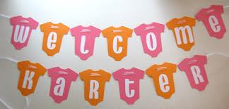
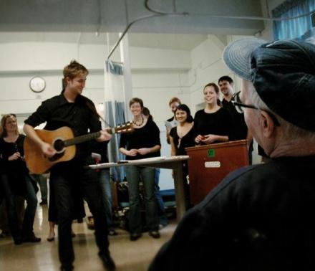
Schedule a New Team Member Welcome Event

Slide 82
Featured Implementation Tool #21
Getting to Know You! Form – as an icebreaker
Then utilize this information in an icebreaker exercise in orientation

Slide 83
Getting to Know You Icebreaker Exercise
After brief introduction, distribute “Getting to Know You!” forms to everyone in the orientation class

Slide 84
Getting to Know You Icebreaker Exercise
When everyone has had a chance to complete the form, collect them and break the ice! For instance, ask the group…

Slide 85
Getting to Know You Icebreaker Exercise
One of our new team members has four siblings, three brothers and one sister. Who is it? Or…
One of our new team members has lived in 6 states and has visited 33. Who is it?

Slide 86
Getting to Know You The Supervisor
Deliver copies of “Getting to Know You” forms to each new team member’s supervisor, prior to the Welcome Gathering Event in the afternoon

Slide 87
Getting to Know You The Supervisor
Ask them to use the forms when introducing the new team member to their department or unit.
Make sure the information is memorized, NOT read!

Slide 88
Getting to Know You The Supervisor
Example: “Our newest team member is Tamara Smith. Tamara has three brothers, has lived all of her life in Michigan and the state she wishes she could visit most is Maine. She is also a fan of Godiva Chocolates!”

Slide 89
Getting to Know You The Supervisor
Supervisors can also use the information as conversation starters to overcome awkward silences. For example: “I see you like Kevin Costner movies. What did you think of ‘Waterworld’?”

Slide 90
Getting to Know You The Mentor
Deliver copies of “Getting to Know You” forms to each new team member’s assigned Mentor, upon introduction at orientation, or at first opportunity after assignment

Slide 91
Getting to Know You The Mentor
If Mentors are part of the introduction in orientation, include their “Getting to Know You” forms with the new team members and use with the ice breaker!

Slide 92
Getting to Know You The Mentor
Orientation
The ‘Welcome Event’
When scheduled together
When introducing to other team members
When having lunch together

Slide 93
Getting to Know You Awards and Recognition
The “Getting to Know You” form contains GREAT ideas for individualized awards or gifts!

Slide 94
Getting to Know You Awards and Recognition
Books (you already know their favorite author!)
Movies (you know their favorite actor)
Music CD’s (you know their favorite genre’ and performers)
Restaurant gift card

Slide 95
Getting to Know You Awards and Recognition
Candy
Hobbies
Sports team
Pets
….more!

Slide 96
Getting to Know You Awards and Recognition
You can buy gifts for…
Birthday
Wedding anniversary
Hire date anniversary
National Recognition Day (ie, National dietary worker’s day)
For positive evaluation

Slide 97
Getting to Know You Awards and Recognition
You can buy gifts for…
Holidays throughout the year
Significant event – achievement
Just because!

Slide 98
Getting to Know You Send a Message!
Using the “Getting to Know You!” form well tells the new team member that they are unique, valued and that you care enough to get to know them

Slide 99
Getting to Know You Send a Message!
It also lets the new hire know that forming relationships is important, so they will begin to form relationships with others, as well

Slide 101
Part 5:
Mentors

Slide 102
Mentor Defined
“A trusted advisor”
Verb - to teach or give advice or guidance to (someone, such as a less experienced person)
Synonyms – coach, counsel, lead, guide, pilot, shepherd, show, tutor

Slide 103
The Point…
Mentors are not just good at their job, they are examples to be followed

Slide 104
Create a Mentor Program
Develop Mentors for:
CNAs
Nurses
Dietary
Housekeeping
Others?

Slide 105
How do you choose a mentor?

Slide 106
Choosing a Mentor/Buddy
Step #1
Mentors should be carefully selected, based on specific criteria, such as:
Length of service – at least 1 year
Attendance standard above average
Positive attitude
No disciplinary actions in prior 12 months
Demonstrates initiative
Respected by colleagues, residents, families and managers

Slide 107
Hand Picked isn’t always best….
“Cream of the Crop” mentor… hand picked by DON… upon closer examination:
19 Occasions of absence – totalling 34 days
138 Occasions of tardiness – totalling over 170 HOURS
46 Occasions of leaving early, before end of shift.
Out of 250 opportunities to show up, show up on time and work the entire shift, she missed it almost 220 times!

Slide 108
Training a Mentor/Buddy
Step #2
Mentors should be trained on:
Employee handbook
Specific job duties for new hires
Benefits
Policies and procedures
Relationship skills
Training techniques – adult learning skills

Slide 109
Buddy/Mentor “Must-Haves”
Mentors must meet their new hire on the first day
Have lunch (or other meal during work) with their new hire at least once a week for the new hire’s first 4 weeks, or more
Complete a skills checklist with their new hire every week for the first 4 weeks. Monthly thereafter for up to a year, if possible
Mentors must maintain good work habits, skills and attendance
Mentors must teach proper methods, techniques

Slide 110
How to Reward a Mentor/Buddy (Sample Only)
Step #3
Mentors should be rewarded based on retention, such as:
$25 bonus when new hired reaches 30 days
$25 bonus when new hire reaches 90 days
$50 bonus when new hire reaches 180 days
$100 bonus when new hire reaches 1 year

Slide 111
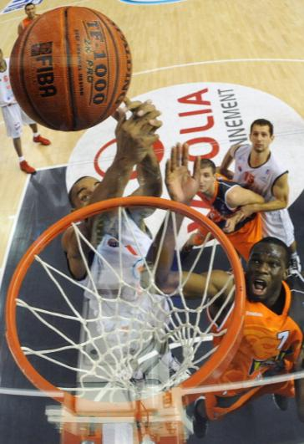
Clarify the Role of Your Mentor/Buddy
Step #4
Mentors should be parallel scheduled with their new hire for at least 2 weeks – sharing one assignment
Mentors should meet and bond with their new hire on the first day of orientation – have lunch with them!
Mentors should be recognized throughout the building – a special name badge, a logoed polo shirt or uniform top, etc.

Slide 112
Clarify the Role of Your Mentor/Buddy
Mentors complete reviews and checklists weekly for four weeks or more.
Mentors should share a meal or break time with new hire at least once a month for the first year. More often if possible.
Mentors maintain a relationship beyond the first four weeks – preferably for life, but at least the first year.
Mentors may receive a pay differential for hours worked with new hire or for all hours worked.

Slide 113
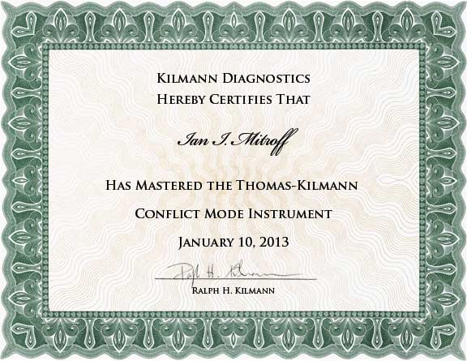
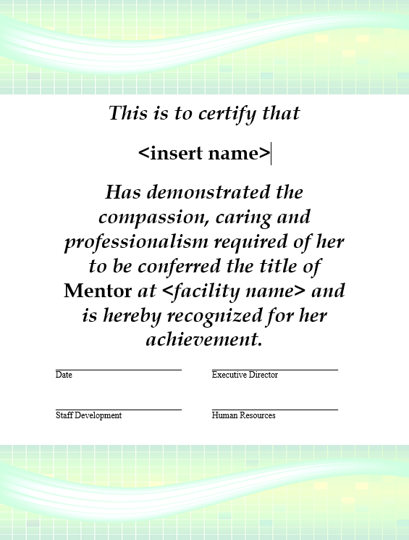
Featured Implementation Tool #24
Sample Mentor Certificate
To be presented after orientation and prior to first assignment at a graduation social

Slide 115
Part 6:
Recognition

Slide 116
If you want your people to perform as stars, you must first help them see themselves as stars

Slide 117
“What gets recognized and rewarded gets repeated.”
– Michael LaBoeuf
Who will you make a hero today?

Slide 118
“The #1 reason people leave jobs is because they don’t feel appreciated”
– Gallup Poll, 2005

Slide 119
Recap – 7 Ways You’ve Already Said You Value New Team Members
These are a few forms we’ve already discussed:
A Welcome Letter with a small token gift
A Welcome Phone Call prior to orientation
Welcome signs with New Hire’s name and department placed in the lobby or entry
Printed place cards for New Hires at orientation
Name badges and time cards at orientation
Getting To Know You forms utilized in introductions
Welcome Event in the department or on the unit

Slide 120
Five More Cool Ways to Invest in Retaining New Team Members
A few other suggestions:
A DVD (their favorite movie from their “Getting To Know You” form?) and a bag of microwave popcorn upon completion of orientation
A plate of homemade cookies at 30 days
An Amazon gift card for their first vacation
A box of personalized business cards at 90 days
$10 worth of scratch-off lotto tickets for successful completion of mentor checklists

Slide 121
“What you focus on you fix, What you ignore you get more.”

Slide 122
Call Offs…
The Achilles Heel of Resident Satisfaction

Slide 123
Is Perfect Attendance a Myth?
Absenteeism in Long Term Care has often been described as:
Chronic – it has been around as long as we’ve been in the business
Epidemic – Routinely runs at 6-10%, often as high as 15 – 20%
Systemic – Some believe “low wages” and “poor staff to resident ratios” are the cause
Unavoidable – It is just the “price of doing business”

Slide 124
The Clinical Price of Call Offs
The effects of sustained high levels of absenteeism (call offs) are real:
Quality indicators suffer with high absenteeism:
Restraint Use
Pressure Ulcers
Catheter Use
Pain Management
And more…
Deficiencies, complaint surveys and other regulatory challenges are increased

Slide 125
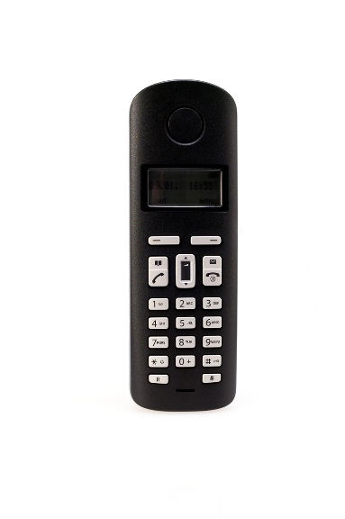
High Call Offs = Low Satisfaction
The effects of sustained high levels of absenteeism (call offs) are real:
Turnover is higher in facilities with high absenteeism
Employee morale suffers
Employee Satisfaction scores are lower
Resident Satisfaction and Family Satisfaction is lower

Slide 126
A Prescription for (Almost) Perfect Attendance
Rewards and recognition
Manager accountability and intervention
Peer accountability
Maintain competitive pay levels at 65th percentile in your market or higher
Recognize Managers with high performing teams
Celebrate milestones – especially 90 days
Thank You Cards

Slide 127
The Caregiver’s Thank You Card
Where should you use it?
What would be the value of sending it to the staff member’s home?
What comments should you write?
What would you like the card (& envelope) to look like and say?
Deadline for production?
:

Slide 128
Prescription… (Continued)
Creative Schedules – such as 12 hour “Resident Centered Scheduling”
Personal Responsibility – Find your own replacement – no harm, no foul
Team based attendance recognition
If team (department/unit/shift) achieves a level of attendance (less than 2% absence, for instance), team receives recognition/reward
If facility achieves a level of attendance (less than 3%, for instance) recognition/reward is presented

Slide 129
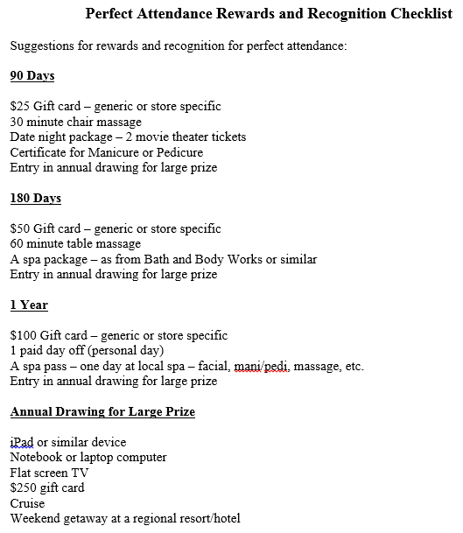
Featured Implementation Tool #31
Creative Ways to Reward (near) Perfect Attendance

Slide 130
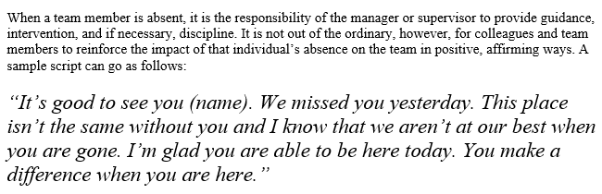
Featured Implementation Tool #32
Peer Attendance Conversation Starter

Slide 132
Part 7:
Checking In

Slide 133
We have a better idea
The “Check-In”

Slide 134
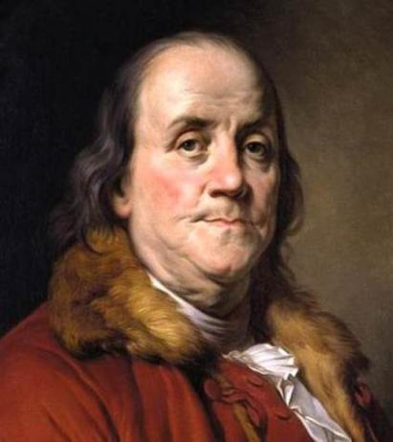
“That which is painful instructs.” – Benjamin Franklin

Slide 135
Check In Before Your New Team Members Check Out!
Managers play an important role in Onboarding
By scheduling regular and on-going “check in” meetings with each New Hire, the organization’s commitment to their success is reinforced

Slide 136
A “Check In” Is:
An opportunity to gain a practical insight into a new team members job satisfaction (or lack), engagement, and retain-ability, before they sour about the job and leave

Slide 137
Six “Not-an-Option Must-Dos”
Check In’s occur:
At the end of the New Hire’s first week.
At the end of second week.
At one month
At three months
At six months
At first anniversary

Slide 138
Feedback
What would be the value and impact of systematically checking in with new team members and receiving feedback:
From co-workers
And checklist information from Mentor (for 1 weeks, 2 weeks, 1 month, and 3 months check in’s)

Slide 139
“A complaint is a gift, and every day is Christmas.”
– Matt Winter, CEO, Allstate

Slide 140
Check In Benefits
From New Hires such as:
Have you met the administrators (1 week)
Is your Mentor helpful in getting comfortable with the routine? (1 week and 2 weeks)

Slide 141
Six Key Questions you need to ask:
Are your co-workers friendly toward you? (all)
Do you feel welcome here? (all)
What do you enjoy most about working here? (all)
Do you have the supplies and equipment you need to do your job? (1 month and beyond)
Have you had the training you need to do you job better? (3 months and beyond)
How can I help you do your job better? (all)

Slide 142
Relationships with Residents from Staff who stay and care… Matters!

Slide 144
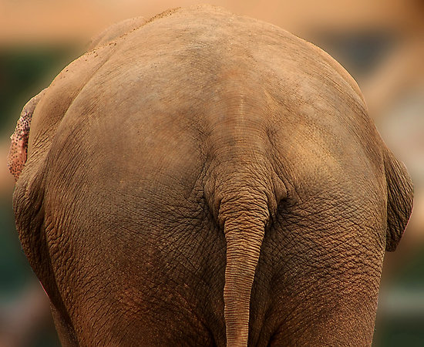
The End

