Slide 1
You’re A Leader! Now Act Like It
With
Greg Efta
Notes:
1

Slide 2
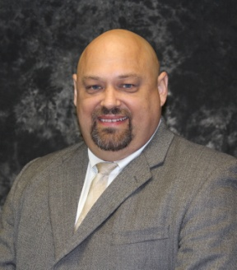
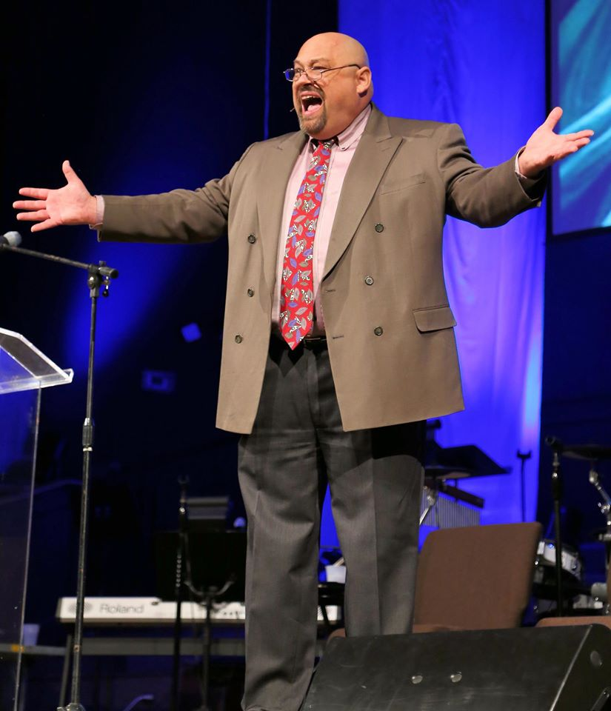
About Greg Efta:
Implementation Specialist at Custom Learning Systems
President of Performance Innovations
Senior Consultant at Maun-Lemke
Co-Founder of The QAPI Gurus, with Michael Bayer
Notes:
2

Slide 3
About Greg Efta:
Music lover – play trumpet and baritone
Husband of 27 years to Heidi
Father of 3 beautiful girls, Maggie, Mackenzie and Melinda
Survivor of 14 mission trips
Ordained Elder in PC-USA and Trained Stephen Minister
Notes:
3

Slide 4
You can find Greg Efta….
At gregefta@gmail.com
At www.gregefta.weebly.com
On Facebook
On Google+
On LinkedIn
Like Performance Innovations on Facebook and have access to “Today’s Nuggets”, “Fun Fact Fridays” and more!
Or the old fashioned way! 407.777.3757
Notes:
4

Slide 5
WHY is Leadership so important?
Definition of Leadership:
Leadership Vs. Management
Notes:
5

Slide 6
WHY is Leadership so important?
People WANT to be led.
People NEED to be led.
People APPRECIATE good leadership.
Notes:
6

Slide 7
Why did I come to HCSEC?
People WILL be led.
SOMEONE will lead them. (Shouldn’t it be YOU?)
Notes:
7

Slide 8
Why is Leadership so important?
A brief clip from an HBO series “The Newsroom” with Jeff Daniels provides us some “talking points” on Leadership.
Be prepared!
The following clip is in its native format. I have not edited it. It DOES contain three instances of profanity. As adults, I think we can overlook it and appreciate the merits of the content, anyway.
Notes:
8

Slide 9
From “The Newsroom” © HBO

Slide 10
12 Leadership Keys…..
Alan Sorkin, who wrote the dialog, identified 12 concepts, or KEYS, that made America the greatest country in the world. Let’s examine them, one at a time.
Notes:
10

Slide 11
Leadership Key # 1:
“We stood up for what was right.”
Leaders stand up for what is right, not for what is:
Convenient, easy, popular, profitable or established (status quo)
Notes:
11

Slide 12
Leadership Key # 2:
“We fought for moral reasons. We passed laws….struck down laws for moral reasons”
Leaders have a solid moral compass and value system.
Notes:
12

Slide 13
Leadership Key # 3:
“We sacrificed.”
Leaders are willing to sacrifice. Rather than focusing on “what’s in it for me”, they focus on “What’s in it for US.”
Notes:
13

Slide 14
Leadership Key # 4:
“We cared about our neighbors.”
Leaders are compassionate and care more about others than themselves.
Notes:
14

Slide 15
Leadership Key # 5:
“We put our money where our mouths were.”
Leaders have “skin in the game.” They are willing to share in the risk and are willing to face consequences.
Notes:
15

Slide 16
Leadership Key # 6:
“And we never beat our chests.”
Leaders are humble. Leaders are modest. Leaders are willing to let others shine.
Notes:
16

Slide 17
Leadership Key # 7:
“We built great big things. Made un-Godly technological advances. Explored the universe. Cured diseases.”
Leaders accomplish. They do. They build. They create. They finish.
Notes:
17

Slide 18
Leadership Key # 8:
“We reached for the stars.”
Leaders are visionary. Leaders inspire and motivate others to greater goals than seem possible.
Notes:
18

Slide 19
Leadership Key # 9:
“Acted like men.”
Leaders are accountable and hold others accountable. They have honor, dignity, respect and responsibility.
Notes:
19

Slide 20
Leadership Key # 10:
“We aspired for intelligence.”
Leaders understand the need for constant development and growth.
Notes:
20

Slide 21
Leadership Key # 11:
“We didn’t identify ourselves by who we voted for in the last election.”
Leaders don’t play identity politics and don’t divide. Leaders unite.
Notes:
21

Slide 22
Leadership Key # 12:
“And we didn’t scare so easy.”
Leaders are courageous.
Notes:
22

Slide 23
You’re a Leader!
Listen to that portion of the clip again, and insert yourself, a leader, as Jeff Daniels lays out what “made America the greatest nation on earth”…. And make your organization, the greatest organization possible.
Notes:
23

Slide 24
You’re a Leader!
Notes:
24

